Slide 1
Project Planning
sdmay25-29

Slide 2
Project Overview
Implement the Atanasoff-Berry Computer using modern technology
The Atanasoff-Berry Computer (ABC) was the first electronic digital computer.
The purpose of the ABC computer was to solve systems of linear equations.
The ABC computer was constructed here at Iowa State.
The original ABC was destroyed in 1948.
We are recreating it as an educational demonstration of how it functioned.
The device that we make will be used as a learning aid to help teach students how computers function.

Slide 3
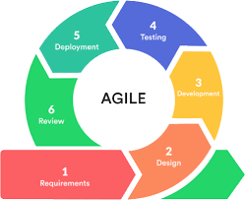
Project Management Style
The project management style we are using is agile. The agile methodology is the best for us because our project is split into many components. Each of us are able to choose a component, design, develop, and test it. Then, we meet twice a week and discuss our progress.

Slide 4
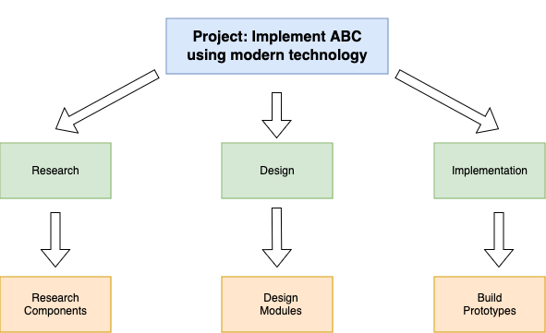
Task Decomposition
Our tasks are split into three main categories
Research
We need to perform extensive research on each component.
Design
We need to design the components using modern technology.
Implementation
We need to build and test our design before ordering them on PCBs

Slide 5
Key Milestones and Evaluation Criteria
Key Milestone #1: Completing our research, design, and implementation of each individual component
We can evaluate how we are doing by considering the amount of components we have to research, design, and build and comparing them with how many have completed.
Key Milestone #2: Combining the components into one functional computer
We can evaluate the functionality of the computer by using a test bench that runs through a large amount of simulations.
Key Milestone #3: Improving user interaction to the point where a user can understand how the computer works
We can evaluate how good our user interaction is by showing it to computer engineering students and asking for feedback.

Slide 6
Key Risks and Mitigation Strategies
Key Risk #1: Computer is not functioning as intended
We are mitigating this risk by prototyping each individual component on breadboards to ensure that they work as intended and that the components work together as intended
Key Risk #2: We are running out of time to complete our project
We are mitigating this risk by keeping a list of tasks that need to be completed and planning for how long these tasks should take us
Key Risk #3: The user interaction is sub-par
We are mitigating this risk by brainstorming ideas for user feedback early. We will also be gathering user feedback once we get to that stage.

Slide 7
Conclusion
In conclusion, the best project management style for us is agile. This is because of the nature of our project in that it can easily be separated into small tasks that do not depend on each other. We have decomposed our task into three main stages: research, design, and prototype. We are considering our progress by keeping track of key milestones and we are aware of certain risks that our project has and have come up with mitigation strategies. Overall, we are prepared for what this project has in store for the future.

